Slide 1
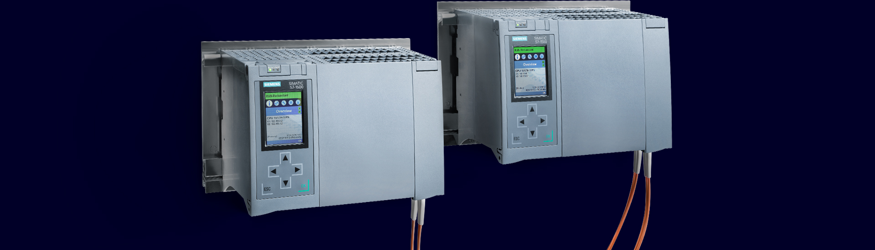
PN System Redundancy with S7-1500 R/H and ET 200
Technical Details (Part 2)

Slide 2
SIMATIC S7-1500 Redundant Systems
Further technical slide sets
This document is part of a three-part set of slides
Part 1: Redundant Systems SIMATIC S7-1500 R/H
Part 2: PROFINET System Redundancy with S7-1500 R/H and ET 200
Part 3: Network configuration with S7-1500 R/H
This document
Legend:
New
New with TIA Portal V18 / Firmware V3.0

Slide 3
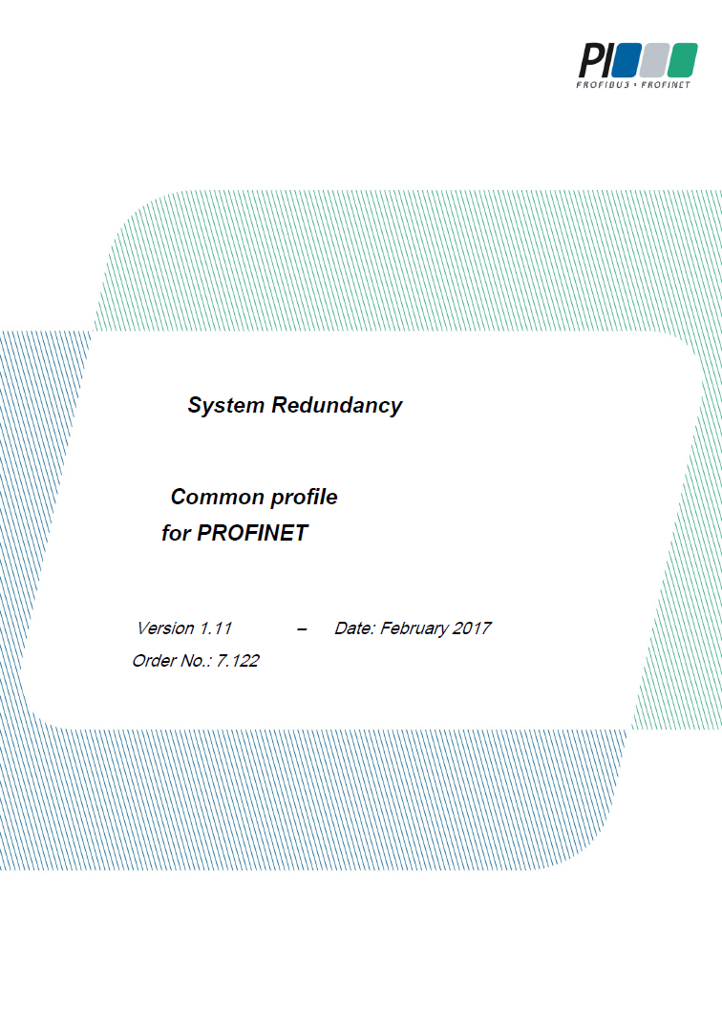
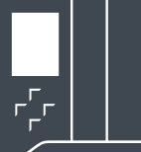


PROFINET System Redundancy
Concept
PROFINET System Redundancy
A system of redundant PN controllers and singular or redundant PN devices.
Three levels:
  PN Controller
  PROFINET network
  PN-Device
The redundancy of one layer is independent of the other layers.
PN
Controller
PN
Controller
PN Controller
PN Controller
PROFINET
Network
2 connections
PN Device

Slide 4
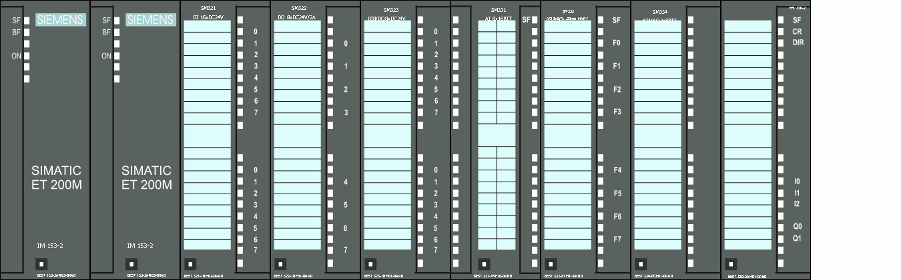
PROFINET System Redundancy
Redundancy operating modes with PROFINET
Without System Redundancy (S1)
System Redundancy S2
System Redundancy R1
Single Interface Modul
1 Connection to the controller
Single Interface Modul
2 Connections to red. controllers
Redundant Interface Module
2x1 Connection to red. Controller
PN Controller
Redundant PN Controller 1
Redundant PN Controller 2
Redundant PN Controller 1
Redundant PN Controller 2
PN IO Network
PN IO Network
PN IO Network
PN IO Network
IM
I/O
IM
I/O
IM
IM
I/O
S1
PN S1 Device
S2
PN S2 Device
R1
PN R1 Device
PN S1 devices can also be operated on redundant controllers S7-1500 R/H with the "Switched S1" function
Controller Redundancy
Network Redundancy
IM Redundancy
Controller Redundancy
Availability
No redundancy
Details on PN System Redundancy operating modes: See https://support.industry.siemens.com/cs/ww/de/view/109756450

Slide 5
PROFINET System Redundancy
Redundancy operating modes with PROFINET
The system tolerates the following failures (Fault Tolerance)
Without System Redundancy (S1)
With System Redundancy S2
With System Redundancy R1
Fault tolerance:
CPU (with bump)
PROFINET Failure
Fault tolerance:
CPU (bumpless)
PROFINET Failure
Fault tolerance:
CPU (bumpless)
PROFINET Failure
Interface Module
Subnet
S1
S2
R1

Slide 6
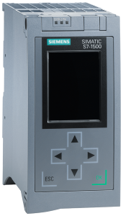
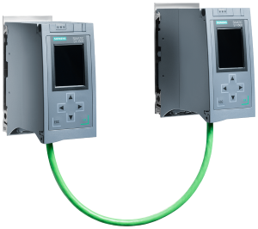
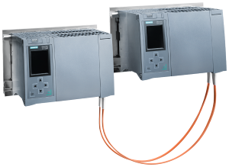
PROFINET System Redundancy
Support of PN System Redundancy with SIMATIC S7-1500
 |  | S7-1500 (Non-redundant) | S7-1500R | S7-1500H
 | Operation of PN devices without System Redundancy | Yes | Yes (Switched S1) | Yes (Switched S1)
 | Operation of PN devices with S2 System Redundancy | Yes (S1 mode only) | Yes | Yes
 | Operation of PN devices with R1 System Redundancy | No | No | Yes from firmware V3.0 and TIA Portal V18
S1
S2
R1

Slide 7
Switching behavior without System Redundancy
Scenario: Controller failure

Slide 8

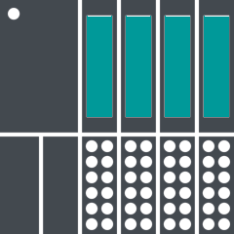
Switching behavior without PROFINET System Redundancy
Initial Situation
S1
Primary
Controller
RUN
RUN
Backup
Controller
Primary CPUs has a
Connection (AR) to the
S1-Device
PROFINET
S1-Device
Process values are exchanged
Process Values
Standard AR

Slide 9
Switching behavior without PROFINET System Redundancy
Scenario: A controller fails – switching process begins
S1
RUN
Primary
Controller
Remaining controller takes over automatically.
There is no connection to the S1 device
PROFINET
S1-Device
I/O Data
Transfer of process values is interrupted. Outputs go to "0" or to substitute value
Process Values
Standard AR

Slide 10
Switching behavior without PROFINET System Redundancy
Scenario: A controller fails - connection establishment
S1
RUN
Primary
Controller
Connection to the S1 device is re-established
PROFINET
S1-Device
I/O Data
Transfer of process values is interrupted¹⁾. Outputs go to "0" or to substitute value
Process Values
Standard AR
¹⁾ Duration depends on the start-up behavior of the S1 device. Minimum approx. 600ms

Slide 11
Switching behavior without PROFINET System Redundancy
Scenario: One Controller Fails - Operation Complete
S1
RUN
Primary
Controller
Remaining controller has a connection to the S1 device
PROFINET
S1-Device
I/O Data
Process values are exchanged
Process Values

Slide 12
Switching behavior with System Redundancy S2
Scenario: Controller failure

Slide 13
Switching behavior with PROFINET System RedundancyS2
Initial Situation
S2
Primary
Controller
RUN
RUN
Backup
Controller
Both CPUs have a
Connection (AR) to the
S2-Device
PROFINET
S2-Device
Process values are exchanged
Process Values
Primary AR
Backup AR

Slide 14
Switching behavior with PROFINET System RedundancyS2
Scenario: A controller fails – switching process begins
S2
RUN
Primary
Controller
Remaining controller takes over automatically.
The existing connection is activated
PROFINET
S2-Device
I/O Data
Process values are used for a very short time¹⁾ frozen:
I/O values remain at the last value
Process Values
Primary AR
Backup AR
¹⁾ S7-1500R 300ms / S7-1500H 50ms

Slide 15
Switching behavior with PROFINET System RedundancyS2
Scenario: One Controller Fails - Operation Complete
S2
RUN
Primary
Controller
Remaining controller has a connection to the S2 device
PROFINET
S2-Device
I/O Data
Process values are exchanged
Process Values
Primary AR
Backup AR

Slide 16
Switching behavior with System Redundancy R1
Scenario: Controller failure

Slide 17
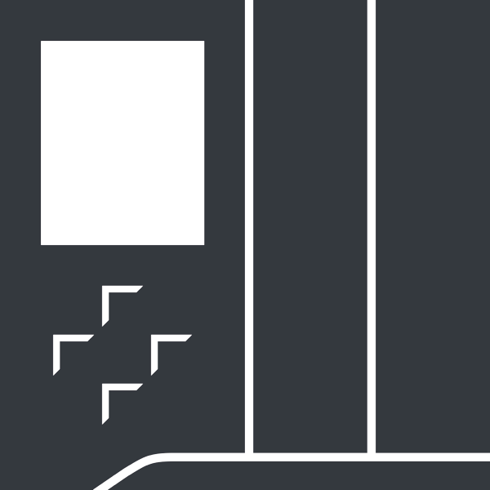
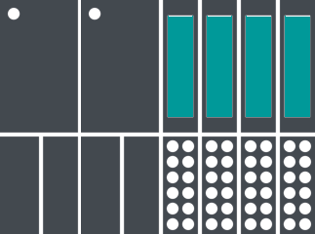
Switching behavior with PROFINET System RedundancyR1
Initial Situation
R1
Primary
Controller
RUN
RUN
Backup
Controller
Primary Controller is connected to Interface Module 1 (IM1)
Backup Controller is connected to Interface Module 2 (IM2)
PROFINET
PROFINET
R1-Device
IM1
IM2
Process values are exchanged
Process Values
Primary AR
Backup AR

Slide 18
Switching behavior with PROFINET System RedundancyR1
Scenario: A controller fails – switching process begins
R1
RUN
Primary
Controller
Remaining controller takes over automatically.
The existing connection is activated
PROFINET
PROFINET
R1-Device
IM1
IM2
Process values are used for a very short time¹⁾ frozen:
I/O values remain at the last value
Process Values
Primary AR
Backup AR
¹⁾ Duration approx. 40ms

Slide 19
Switching behavior with PROFINET System RedundancyR1
Scenario: One Controller Fails - Operation Complete
R1
RUN
Primary
Controller
Remaining controller has a connection to interface module 2
PROFINET
PROFINET
R1-Device
IM1
IM2
Process values are exchanged
Process Values
Primary AR
Backup AR

Slide 20
Switching behavior with System Redundancy R1
Scenario: Failure of a PROFINET interface module

Slide 21
Switching behavior with PROFINET System RedundancyR1
Initial Situation
R1
Primary
Controller
RUN
RUN
Backup
Controller
Primary Controller is connected to Interface Module 1 (IM1)
Backup Controller is connected to Interface Module 2 (IM2)
PROFINET
PROFINET
R1-Device
IM1
IM2
Process values are exchanged
Process Values
Primary AR
Backup AR

Slide 22
Switching behavior with PROFINET System RedundancyR1
Scenario: An interface module fails – switching process begins
R1
Primary
Controller
RUN
RUN
Backup
Controller
Backup Controller enables connection to
Interface-Module 2 (IM2)
PROFINET
PROFINET
R1-Device
IM1
IM2
Process values are used for a very short time¹⁾ frozen:
I/O values remain at the last value
Process Values
Primary AR
Backup AR
¹⁾ Duration approx. 40ms

Slide 23
Switching behavior with PROFINET System RedundancyR1
Scenario: An interface module fails - operation complete
R1
Primary
Controller
RUN
RUN
Backup
Controller
I/O data is transferred via sync line via the backup controller to the
Primary controller.
There is no controller switching.
PROFINET
PROFINET
R1-Device
IM1
IM2
Process values are exchanged
Process Values
Primary AR
Backup AR

Slide 24
Siemens products with System Redundancy function
SIMATIC S7-1500 Redundant Systems

Slide 25
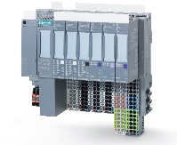
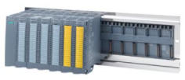
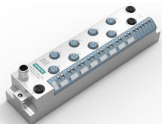
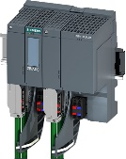
PROFINET System Redundancy
Siemens I/O systems with PN S2 function (I)
S2
Product |  | Article
ET 200SP IM155-6 PN HF (FW>=4.2) IM 155-6MF (Multi Fieldbus) |  | 6ES7155-6AU01-0CN0 6ES7155-6AU30-0CN0 6ES7155-6MU00-0CN0
ET 200MP IM155-5 PN HF (FW>=4.2) Also with active backplane bus for pulling/plugging in operation |  | 6ES7155-5AA00-0AC0 6ES7590-0BL00-0AA0 The active backplane bus allows the pulling and plugging of ET 200MP modules while the CPU is in operation.
ET 200eco PN M12-L (from FW 1.1) |  | 6ES7 14*-6**00-0BB0
PN/PN coupler |  | 6ES7158-3AD10-0XA0
Overview in detail: https://support.industry.siemens.com/cs/ww/en/view/102325771

Slide 26
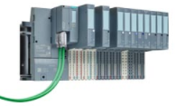
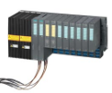
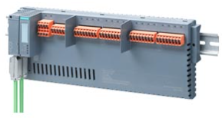
PROFINET System Redundancy
Siemens I/O systems with PN S2 function (II)
S2
Product |  | Article
ET 200SP HA IM155-6 PN HA (with Single IM) (without F-Modules) |  | 6DL1155-6AU00-0PM0
ET 200iSP IM 152-1PN (with Single IM) (without F-Modules) For use in Ex zone 1 |  | 6ES7152-1BA00-0AB0
SIMATIC CFU Compact Field Unit Enables the connection of PROFIBUS PA field devices |  | 6ES7655-5PX11-1XX0

Slide 27
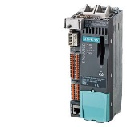
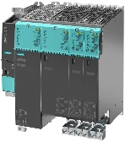
PROFINET System Redundancy
Siemens drives with PN S2 function
S2
Product |  | Article
SINAMICS S120, S150, G130, G150 with CU310-2PN (FW >=5.1 HF1) (as GSDML) |  | 6SL3040-1LA01-0AA0
SINAMICS S120, S150, G130, G150 with CU320-2PN (FW >= 5.1 HF1) (as GSDML) |  | 6SL3040-1MA01-0AA0
An application example exists for configuring the SINAMICS drives on S7-1500R/H: https://support.industry.siemens.com/cs/ch/en/view/109744811

Slide 28
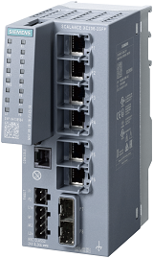
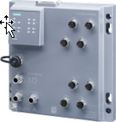
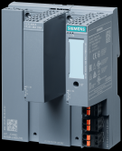
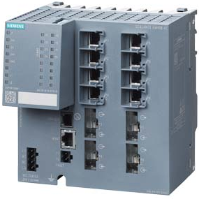

PROFINET System Redundancy
Switches with PN S2 function
S2
Product |  | Article
SCALANCE XC-200 series |  | 6GK5 2 . . - . . . 00 - 2 . C2
SCALANCE XP-200 Serie |  | 6GK5 2 . . - 0 . A00 - . . S6
SCALANCE XF204-2BA |  | 6GK5 204-2AA00-2GF2
SCALANCE X400 from FW 6.3 |  | 6GK5408-. G.00-2AM2 6GK5416-. G.00-2AM2
SCALANCE X500 from FW 6.3 |  | 6GK552 . - . . . 00 - . AR2

Slide 29
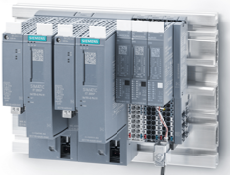
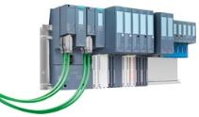
PROFINET System Redundancy
Siemens I/O systems with PN R1 function
R1
Product |  | Article
ET 200SP IM155-6 PN R1(with redundant IM) |  | 6ES7155-6AU00-0HM0
ET 200SP HA IM155-6 PN HA (with redundant IM) (without F-Modules) |  | 6DL1155-6AU00-0PM0
ET 200iSP IM155-6 PN HA (with redundant IM) (without F-Modules) |  | 6ES7152-1BA00-0AB0

Slide 30
System Redundancy R1 with ET 200SP
SIMATIC S7-1500 Redundant Systems

Slide 31
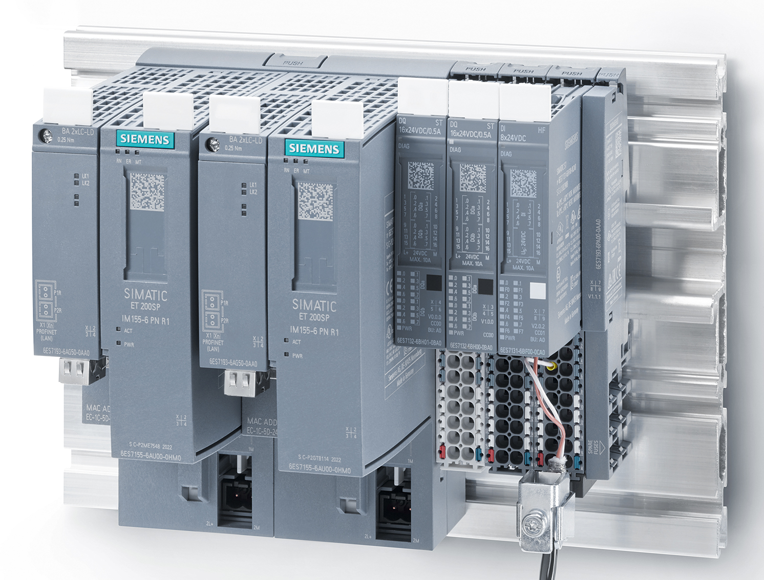
PROFINET System Redundancy
ET 200SP with System Redundancy R1
An ET 200SP R1 system consists of:
2x IM 155-6 PN R1
1x BU-Type M0
2x same bus adapters from the ET 200SP spectrum
1x SIMATIC system rail
Any IO modules
2
4
1
2
5
3
3
3
1
1
4
5
Notes:
Hot swapping (module replacement during runtime of the CPU) is possible also with multiple modules through the use of the active backplane bus for the ET 200MP. Up to 12 S7-1500 / ET 200MP modules can be inserted per station.

Slide 32
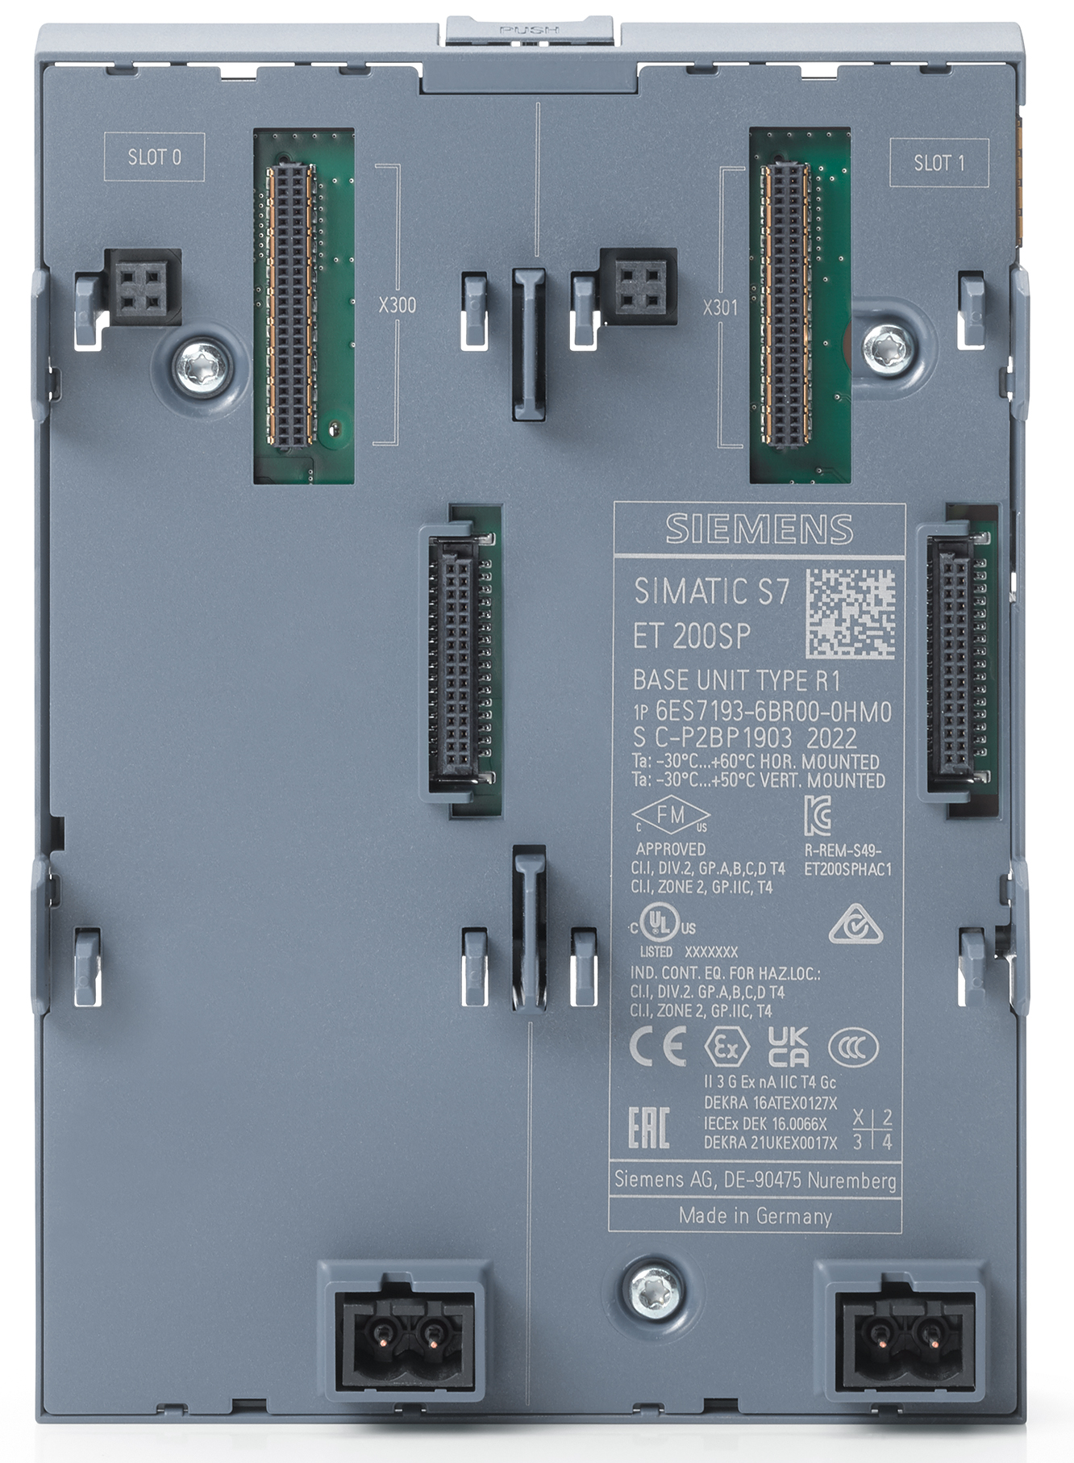
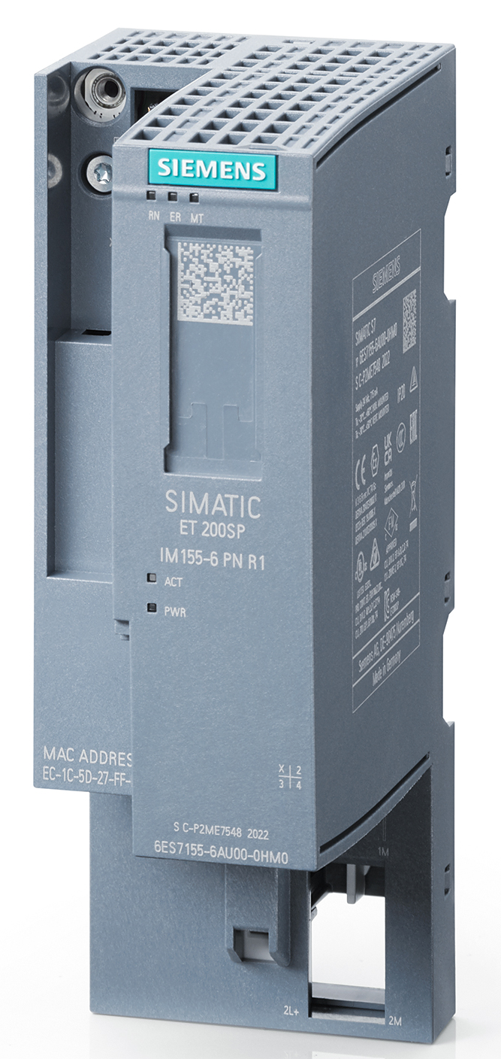
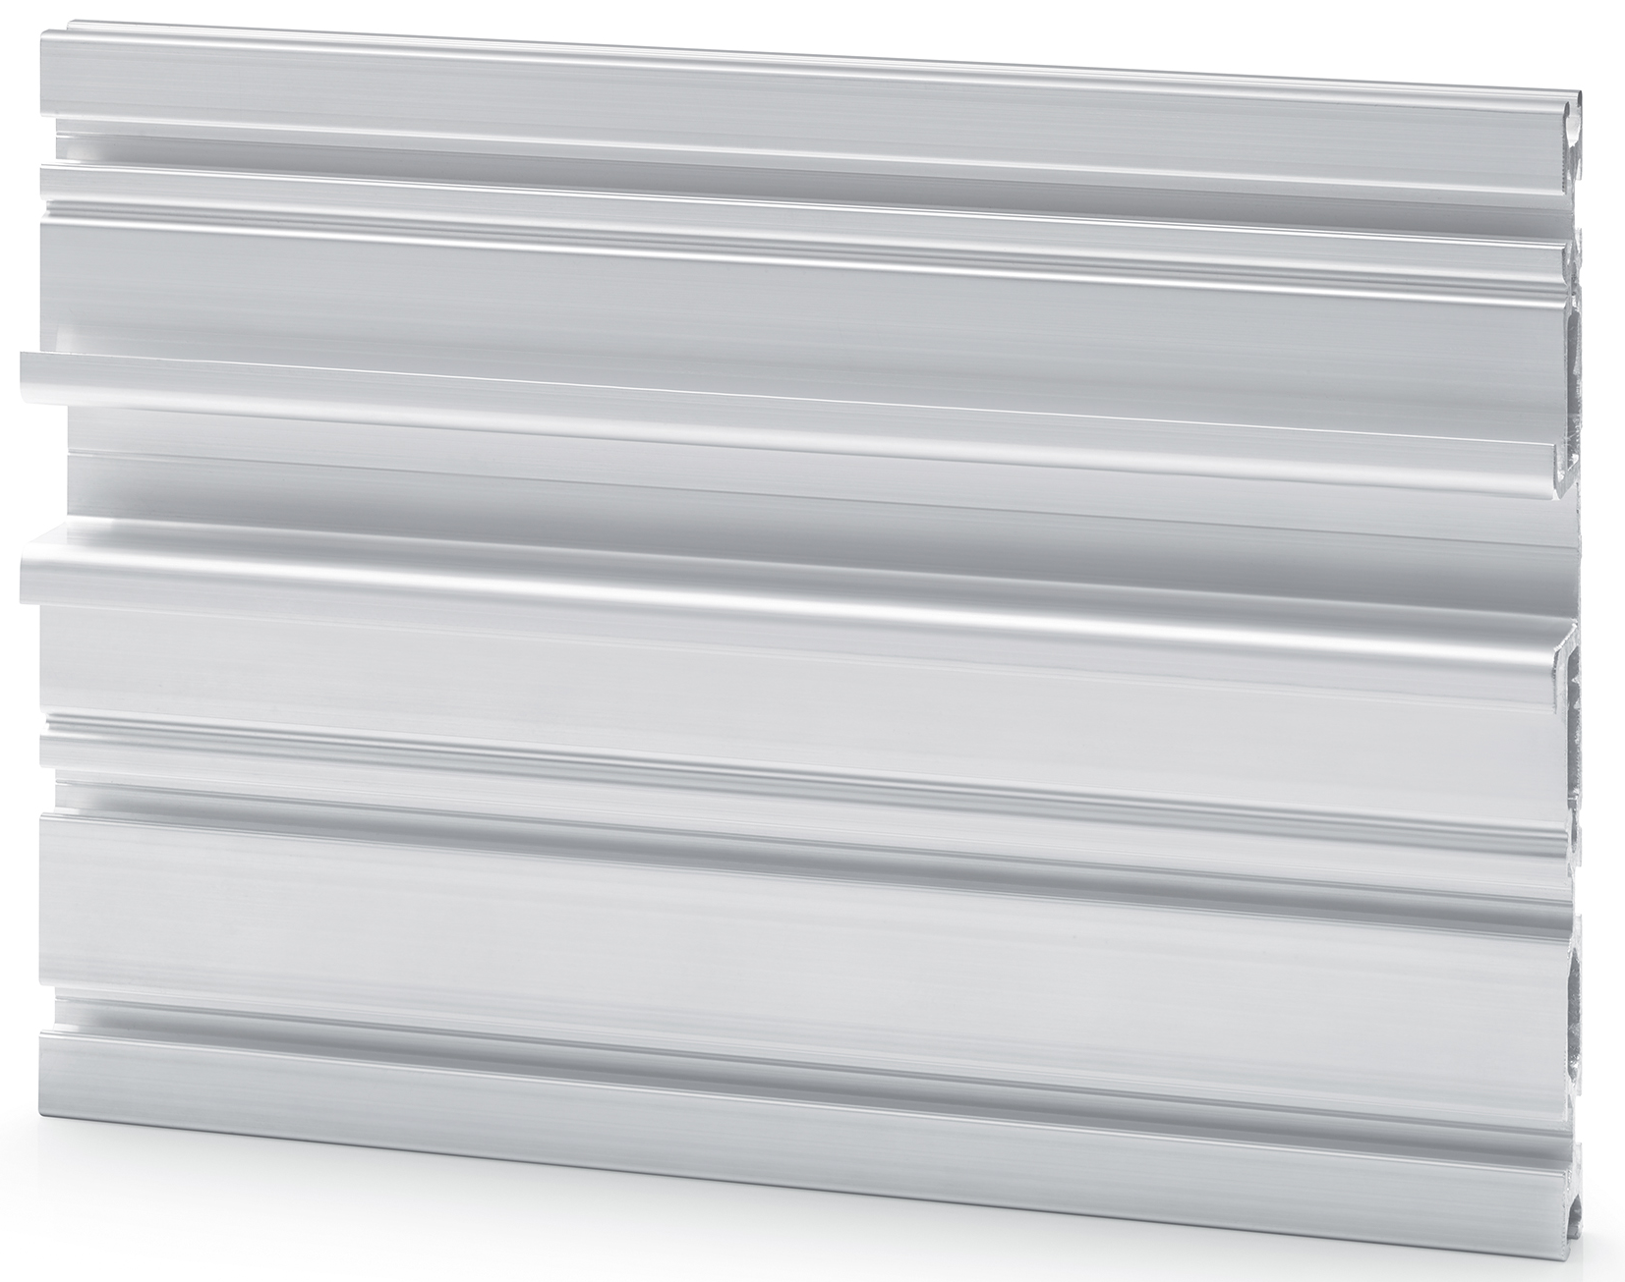
ET 200SP with System Redundancy R1
Ordering data
Designation | Article
IM 155-6 PN R1 | 6ES7155-6AU00-0HM0
BU Type M0 | 6ES7193-6BR00-0HM0
SIMATIC system rail, Length 482,6mm | 6ES7193-6MR00-0AA0
SIMATIC system rail, Length 530mm | 6ES7193-6MR00-0BA0
SIMATIC system rail, Length 830mm | 6ES7193-6MR00-0CA0
SIMATIC system rail, Length 2000mm | 6ES7193-6MR00-0DA0
2
1

Slide 33
ET 200SP with System Redundancy R1
System Rail
Required when using the IM 155-6 PN R1
Tight dimensional tolerances for operating conditions under high mechanical stress (significantly better than dimensional tolerance standard EN 60715)
long-term stable surface treatment for optimum interference dissipation
stable design for self-supporting construction
integrated Bosch profile grooves (6mm profile grooves, B-type)

Slide 34
Configuration System Redundancy R1
SIMATIC S7-1500 Redundant Systems

Slide 35
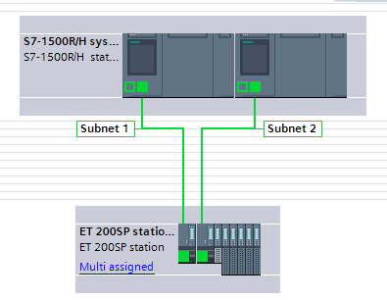
Configuration System Redundancy R1
Option 1: Separate subnets
1 subnet is used between controller and IO device.
Advantage:
Same (symmetric) IP addresses in both networks can be used
Disadvantage:
No double-sided connection of S1 or S2 devices possible (via Y-Switch)

Slide 36
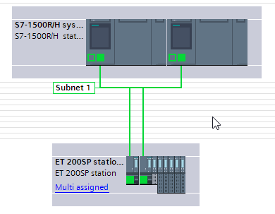
Configuration System Redundancy R1
Option 2: Shared subnet
Controller and IO devices are connected to a common subnet
Advantage:
Allows two-sided connection of S1 or S2 devices via Y-Switch
Disadvantage:
No symmetric IP addresses possible

Slide 37
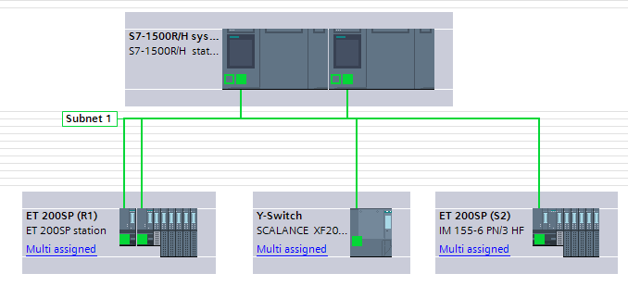
Configuration System Redundancy R1
Option 2: Shared subnet – configuration with S1 and S2 IO devices
R1-Device
Y-Switch
S2-Device
Y-Switch Details: See Slides Part 3 "Network configuration with S7-1500 R/H“

Slide 38
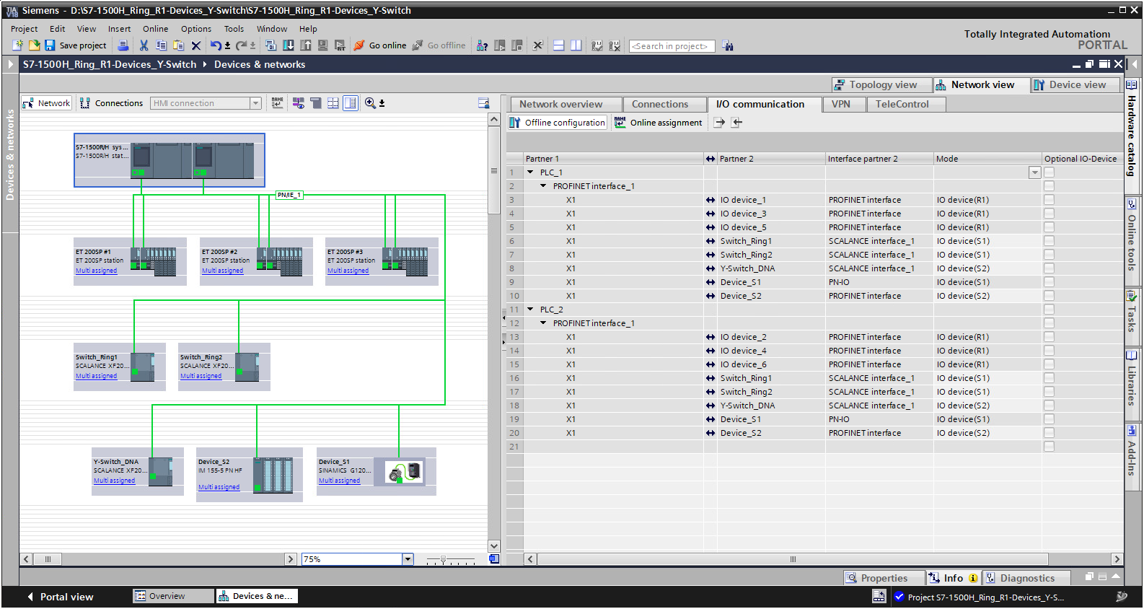
Configuration System Redundancy
Display of the redundancy mode in the TIA Portal
The distinction S1/S2/R1 is displayed in the "Mode" column in the "EA Communication" table.
Here: ET 200MP: S2 Redundancy
In the network view, S1, S2 and R1 devices are displayed as "Multi-Assigned"

Slide 39
Disclaimer
© Siemens 2022
Subject to changes and errors. The information given in this document only contains general descriptions and/or performance features which may not always specifically reflect those described, or which may undergo modification in the course of further development of the products. The requested performance features are binding only when they are expressly agreed upon in the concluded contract.
All product designations may be trademarks or other rights of
Siemens AG, its affiliated companies or other companies whose use by third parties for their own purposes could violate the rights of the respective owner.

Slide 40
Contact
Publisher: Siemens 2022

